Slide 1
Decision structures

Slide 2
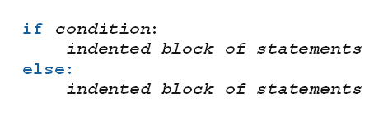
if-else Statements
Also known as branching structures
Allow program to decide on course of action
Based on whether a certain condition is true or false.
Form:

Slide 3
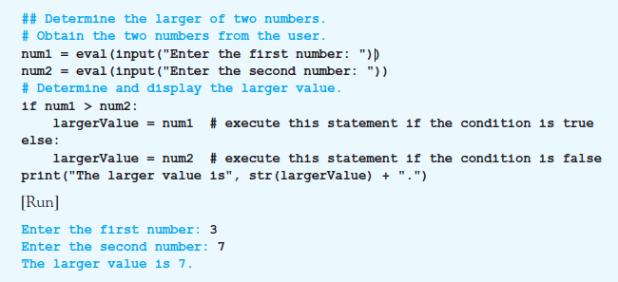
if-else Statements
Example 1: Program finds larger of two numbers input by user.

Slide 4
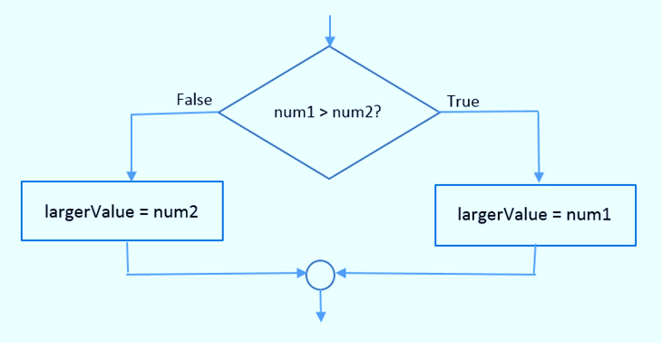
if-else Statements
FIGURE 3.1 Flowchart for the if-else statement in Example 1.

Slide 5
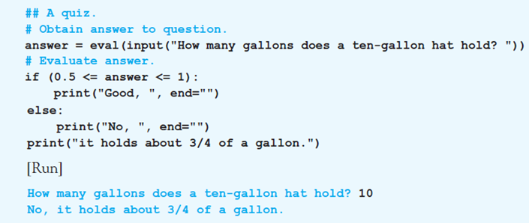
if-else Statements
Example 2: if-else statement in program has relational operators in its condition.

Slide 6
if Statements
The else part of an if-else statement can be omitted
When the condition is false
Execution continues with line after the if statement block

Slide 7
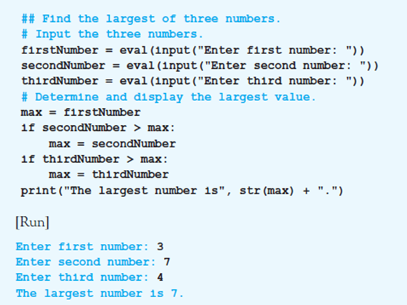
if Statements
Example 3: Program contains two if statements

Slide 8
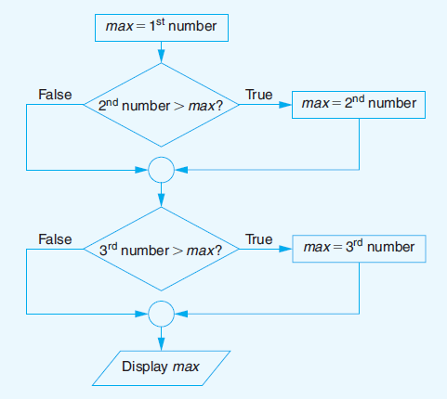
if Statements
FIGURE 3.2 Flowchart for Example 3.

Slide 9
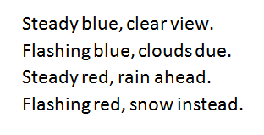
Nested if-else Statements
Indented blocks of if-else and if statements can contain other if-else and if statements
The if-else statements are said to be nested
Consider the task of interpreting a beacon
The color of the beacon light atop Boston’s old John Hancock building forecasts the weather

Slide 10
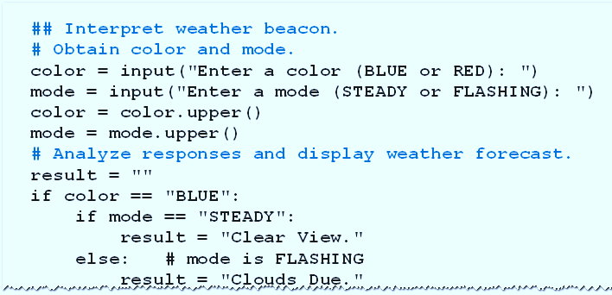
Nested if-else Statements
Example 4: Program requests a color (Blue or Red) and a mode (Steady or Flashing) as input
Then displays the weather forecast

Slide 11
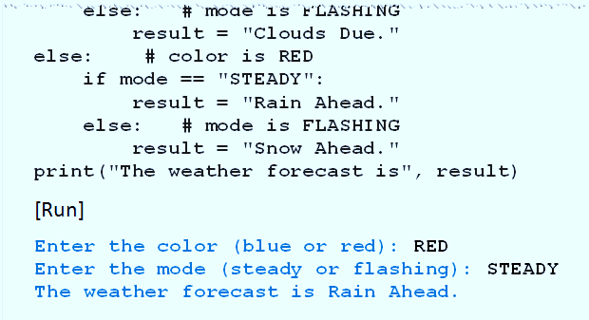
Nested if-else Statements
Example 4: Program requests a color (Blue or Red) and a mode (Steady or Flashing) as input
Then displays the weather forecast

Slide 12
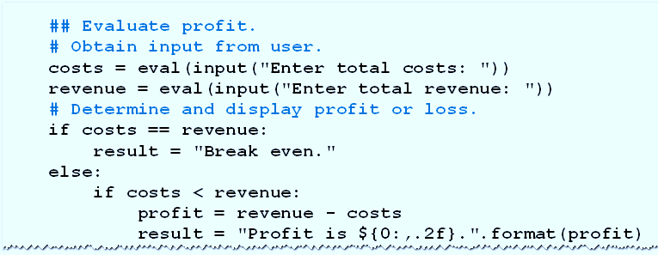
Nested if-else Statements
Example 5: Program requests costs, revenue for company
Displays “Break even”, profit, or loss

Slide 13
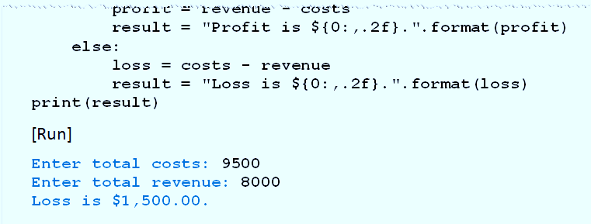
Nested if-else Statements
Example 5: Program requests costs, revenue for company
Displays “Break even”, profit, or loss

Slide 14
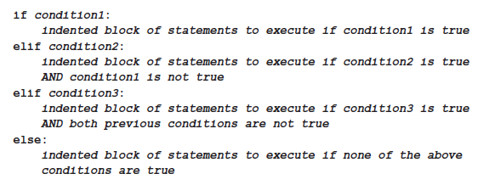
The elif Clause
Allows for more than two possible alternatives with inclusion of elif clauses.

Slide 15
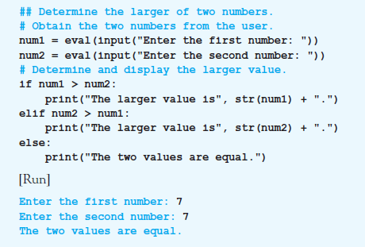
The elif Clause
Example 6: Program reports if the two numbers are equal.

Slide 16
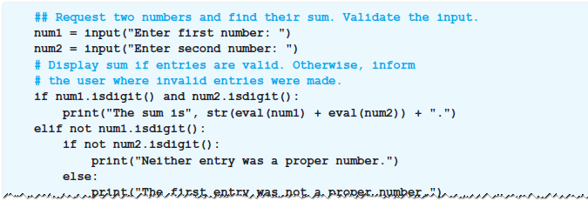
Input Validation with if-elif-else Statements
Example 9: Program uses the method isdigit to guard against improper input.

Slide 17
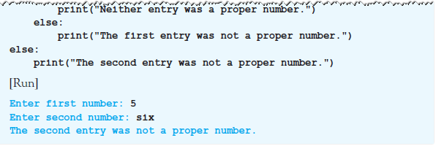
Input Validation with if-elif-else Statements
Example 9: Program uses the method isdigit to guard against improper input.

Slide 18
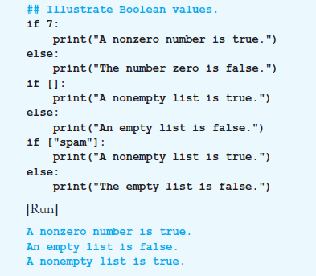
True and False
Example 10: Program illustrates truth values of objects

Slide 19
END

